Slide 1
Who wins depends on who you hear
MULTI-AGENT ELECTION LAB
A simulated town of 300 voters. We change one condition at a time and watch who wins.
Team Eclipse · 9 November 2026
Notes:
We work on elections, and on a few things that happen in them that we found interesting: people voting tactically, people following the crowd, people only seeing what their friends do, and small groups trying to sway everyone else. To study them we use our team's multi-agent election engine. It simulates a town of 300 voters who vote again and again, and every voter reacts to the votes they saw in the previous round. The method for the whole talk is simple: we keep the town the same and change one condition at a time, and then we look at whether the winner changes. Every animation you will see is replayed from real runs of that engine, not drawn by hand.

Slide 2
Does the winner depend only on what people prefer, or also on how they reason and what they can see?
THE QUESTION
EXPERIMENT 1
EXPERIMENT 2
EXPERIMENT 3
EXPERIMENT 4
Everyone sees everything
How voters reason
Who they can hear
Who tries to sway them
84 voter mixes × 30 towns
5 hearing radii, walking or still, × 30 towns
A loyal 10% with 0 to 80 followers × 30 towns
Full information · 30 towns · 40 rounds
Notes:
Here is the one question behind the whole talk. In school we learn that an election adds up what people prefer. But real voters also reason about the election: is my candidate even viable, what are my friends voting for. And they only see part of what everyone else is doing. So we ask: does the winner depend only on preferences, or also on how people reason and what they can see? We answer it in four steps, and each step adds one thing. Experiment 1: everyone sees everything, the cleanest case. Experiment 2: we change how voters reason, by changing the mix of voter types. Experiment 3: we limit what each person can hear, and let people move around so their contacts change. Experiment 4: we add a small organised group that tries to sway everyone else. Opinions stay exactly the same in all four. If the winner changes, it is because of the condition we changed.

Slide 3
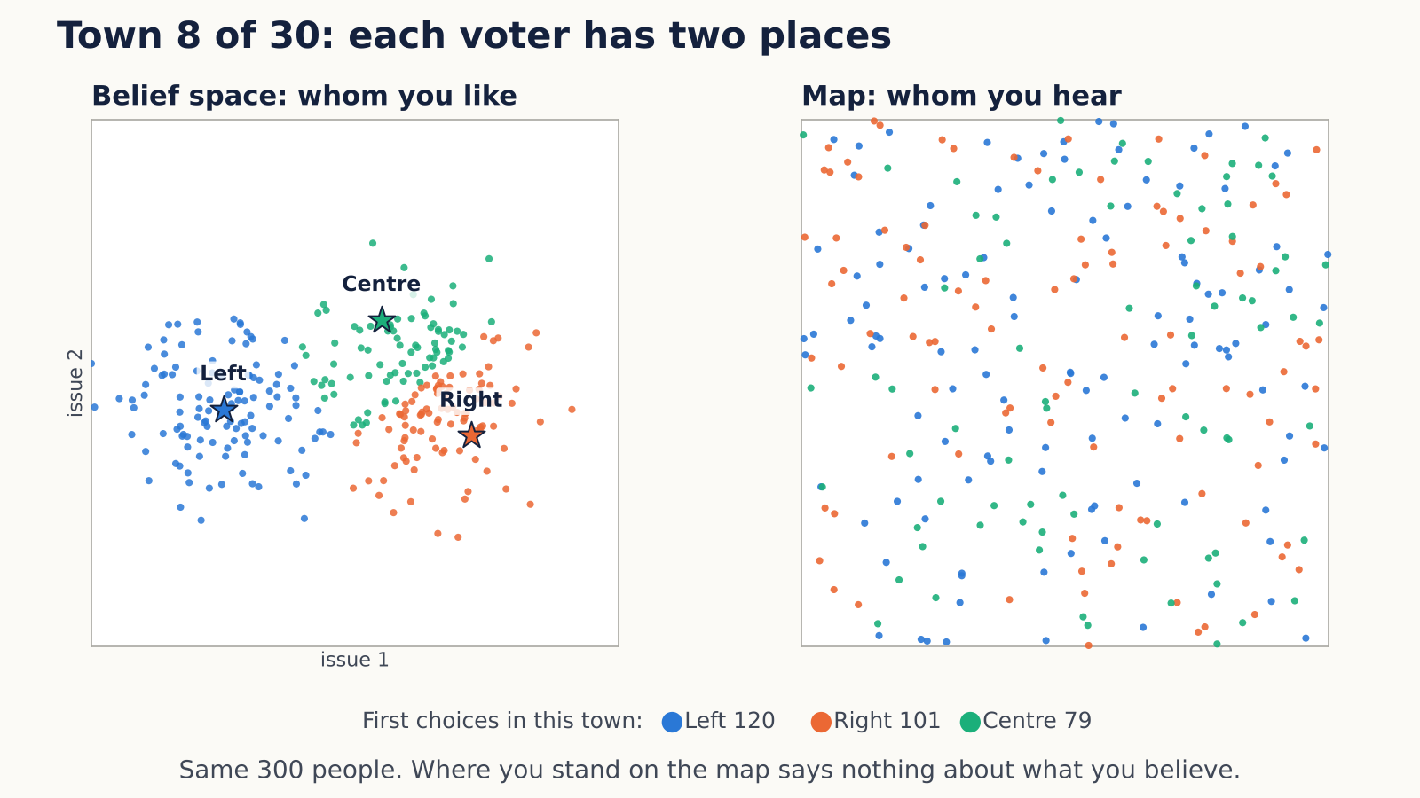
300 voters, each in two places
THE TOWN
BELIEF SPACE: WHOM YOU LIKE
A fixed point on two issues. You rank Left, Right and Centre by distance, nearest first.
TWO CAMPS
40% near Left. 60% on the right side, split between Right and Centre.
MAP: WHOM YOU HEAR
A random spot, unrelated to your beliefs. It matters from Experiment 3.
Town 8 of 30. First choices: Left 120, Right 101, Centre 79. Each dot keeps its colour, its favourite, as it moves to a random spot on the map.
Opinions: 120 voters drawn around (0.25, 0.45), 180 around (0.64, 0.50), spread 0.10 per issue · same recipe in all 30 towns
Notes:
This is our town. Every voter is a dot, and every voter lives in two places at once. The left square is the belief space. Think of it as two issues, say the economy on one axis and social questions on the other. Each voter has a fixed point there, and they like candidates that are close to them. The three stars are the candidates: Left, Right and Centre. A voter sitting near the Left star ranks Left first, and so on. The colour of a dot is that voter's favourite. Opinions come in two camps. About 40 percent of people sit around Left. The other 60 percent sit on the right side, and that camp is split: some are closer to Right, some closer to Centre. Now watch the dots fly. Every voter also stands somewhere on a separate map, and that spot is random. It has nothing to do with what they believe, so the colours get completely mixed: your neighbour on the map can think the opposite of you. The clip is town 8 of our 30. Its first choices are Left 120, Right 101 and Centre 79, which is close to the typical town. The map decides whom you hear. We will not need it until Experiment 3, but this is where it comes from. Opinions never change during an election; that stays true for the whole talk.

Slide 4
The counting rules disagree
THE TOWN
118.5
98
83
HEAD TO HEAD
Centre beats Left 180 to 120 and Right 198 to 102.
first choices for Left
for Right
for Centre
Counting rule | Winner
Plurality: most first choices | Left
Instant runoff | Right (27 of 30)
Borda points | Centre
Beats everyone head to head | Centre
From here on: plurality, one name per voter.
Every result is over 30 towns: 30 random draws of this recipe, and the same 30 in every experiment.
Medians over the 30 towns; ranges: Left 111–128, Right 87–110, Centre 70–99 · Centre wins both head-to-heads in all 30
Notes:
Before any strategy, here is why this town is interesting. Count everyone's favourite and Left is biggest, with about 118 of 300 first choices, then Right with 98 and Centre with 83; these are medians over the 30 towns. But Centre is almost everybody's second choice. Head to head, Centre beats Left 180 to 120 and beats Right 198 to 102. So the textbook counting rules disagree. Plurality, where the most first choices wins, picks Left. Instant runoff usually drops Centre first, and most of Centre's voters prefer Right to Left, so Right wins in 27 of 30 towns. Borda points and the head-to-head rule both pick Centre. The point: even with fixed opinions, who wins already depends on the rules of the game. From now on we keep one rule fixed: plurality, one name per voter, as in the UK, the US or India. What we vary is how people vote, and what they can see. One more thing about the word town. A town is one random draw of this recipe: where everyone's opinion falls, where they stand on the map, which type each person is. We use 30 of them so a result is not a fluke of one lucky draw, and the same 30 are reused in every experiment. When I say Left wins 30 of 30 towns, it means it won in all 30 draws.

Slide 5
The 4 Types of Voters
VOTER RULES
Sincere · 40%
Front-runner · 30%
Copycat · 20%
Pivot-seeker · 10%
“I vote for my favourite.”
“Only the top two can win. I stay with mine if it's there, else I pick the better of the two.”
“I vote for the most common vote I see.”
“I switch only if my one vote changes the winner.”
Control
Local majority
Baumeister et al. 2020
Tsang et al. 2018, Top-K
Round 0: everyone votes for their favourite.
Every round after: everyone votes at once, reacting to last round's votes they can see.
Engine policies: sincere, top_k (K = 2), sensed_plurality, pivotal · types are assigned at random, whatever a voter's opinion
Notes:
Now the people. Every voter has one of four types, and the default town is 40, 30, 20 and 10 percent. Sincere voters, 120 people, always vote for their favourite, whatever happens. They are our anchor. Front-runners, 90 people, believe only the top two can win. Each round they look at the votes they can see and find the two leaders. If they already back one of the two, they stay. If not, they move to whichever of the two they like more. Example: a Centre fan who sees Left and Right leading moves to Right, because they prefer Right to Left. That is the classic don't-waste-your-vote voter. Copycats, 60 people, vote for the most common vote they see, whatever their own preference. That is the bandwagon, or herd, voter. Pivot-seekers, 30 people, only switch if their single vote would change who wins. In a town of 300 that almost never happens, so in practice they behave like sincere voters, and you will see that in the data. The timing: in round 0 everyone votes for their favourite. Then, every round, everyone looks at last round's votes they can see and votes again, all at the same time. We run 40 rounds, and 150 in some long runs.

Slide 6
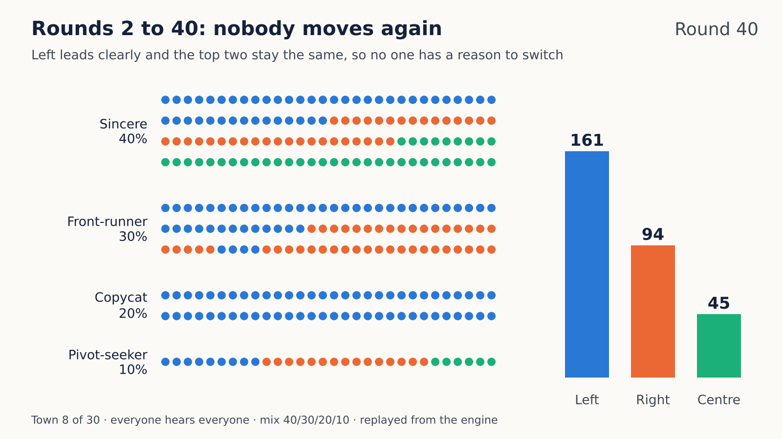
Everyone hears everyone
EXPERIMENT 1 · THE BASELINE
THE BASELINE
Everyone sees the true count of last round's votes. Default mix 40/30/20/10.
WHAT WE GOT
Frozen after one round in all 30 towns. Left wins all 30; Centre falls from 83 to 41 votes (median).
WHY IT STOPS
Round 1's count has the same top two as round 0, so it points everyone to the vote they already cast. Proved for each of the 30 towns.
WHY 30 TOWNS
Town 8 of 30. Round 0, everyone votes their favourite: Left 120, Right 101, Centre 79. In round 1, 62 voters switch: 161, 94, 45. Then nobody moves.
Each town is one random draw of opinions, map spots and voter types. One town could be luck; 30 show the pattern. The same 30 are used in every experiment.
Medians over the 30 towns: Left 118.5 → 159 votes, Right 98 → 98.5, Centre 83 → 41
Notes:
Experiment 1 is our baseline, the true thing: everyone sees the true count of last round's votes, as if one accurate poll were shared with the whole town. Nothing else is added, and the mix of types is the default 40, 30, 20, 10. Watch the clip. It is town 8. Each dot is a voter, grouped by type and coloured by their vote. In round 0 everyone votes for their favourite: Left 120, Right 101, Centre 79. In round 1 everyone reacts to that count at the same time. Copycats see Left on top and jump to Left, even Right and Centre fans. Front-runners see Left and Right as the top two: those already on Left or Right stay, and those on Centre move, mostly to Right, because most Centre fans prefer Right to Left. Sincere voters and pivot-seekers stay put. 62 voters switch, and the count becomes Left 161, Right 94, Centre 45. After that, nobody ever moves again. Why it stops: the round-1 count shows the same top two as round 0, here Left and Right, with gaps too big for any single vote to change. Every rule only looks at who the top two are, so the count points everyone to the vote they already cast: copycats are already on Left, front-runners are already on one of the two. That is a proof, not just a simulation, and we checked its condition in every one of the 30 towns: round 1 always keeps round 0's top two, Left and Right in 27 towns, Left and Centre in the other 3. It is not automatic, by the way: when counts are nearly tied, votes can loop forever, which is why we check it town by town. Why 30 towns? A town is one random draw: where everyone's opinion falls, where they stand on the map, and which type each person is. One town could be a lucky draw, so we use 30, and we reuse the same 30 in every experiment. So when the winner changes later, it is because of the condition we changed, not because the towns changed. Result across all 30: frozen after one round in every town, Left wins all 30, and Centre falls from a median of 83 votes to 41, even though Centre beats both rivals head to head. This is the reference point for everything that follows.

Slide 7
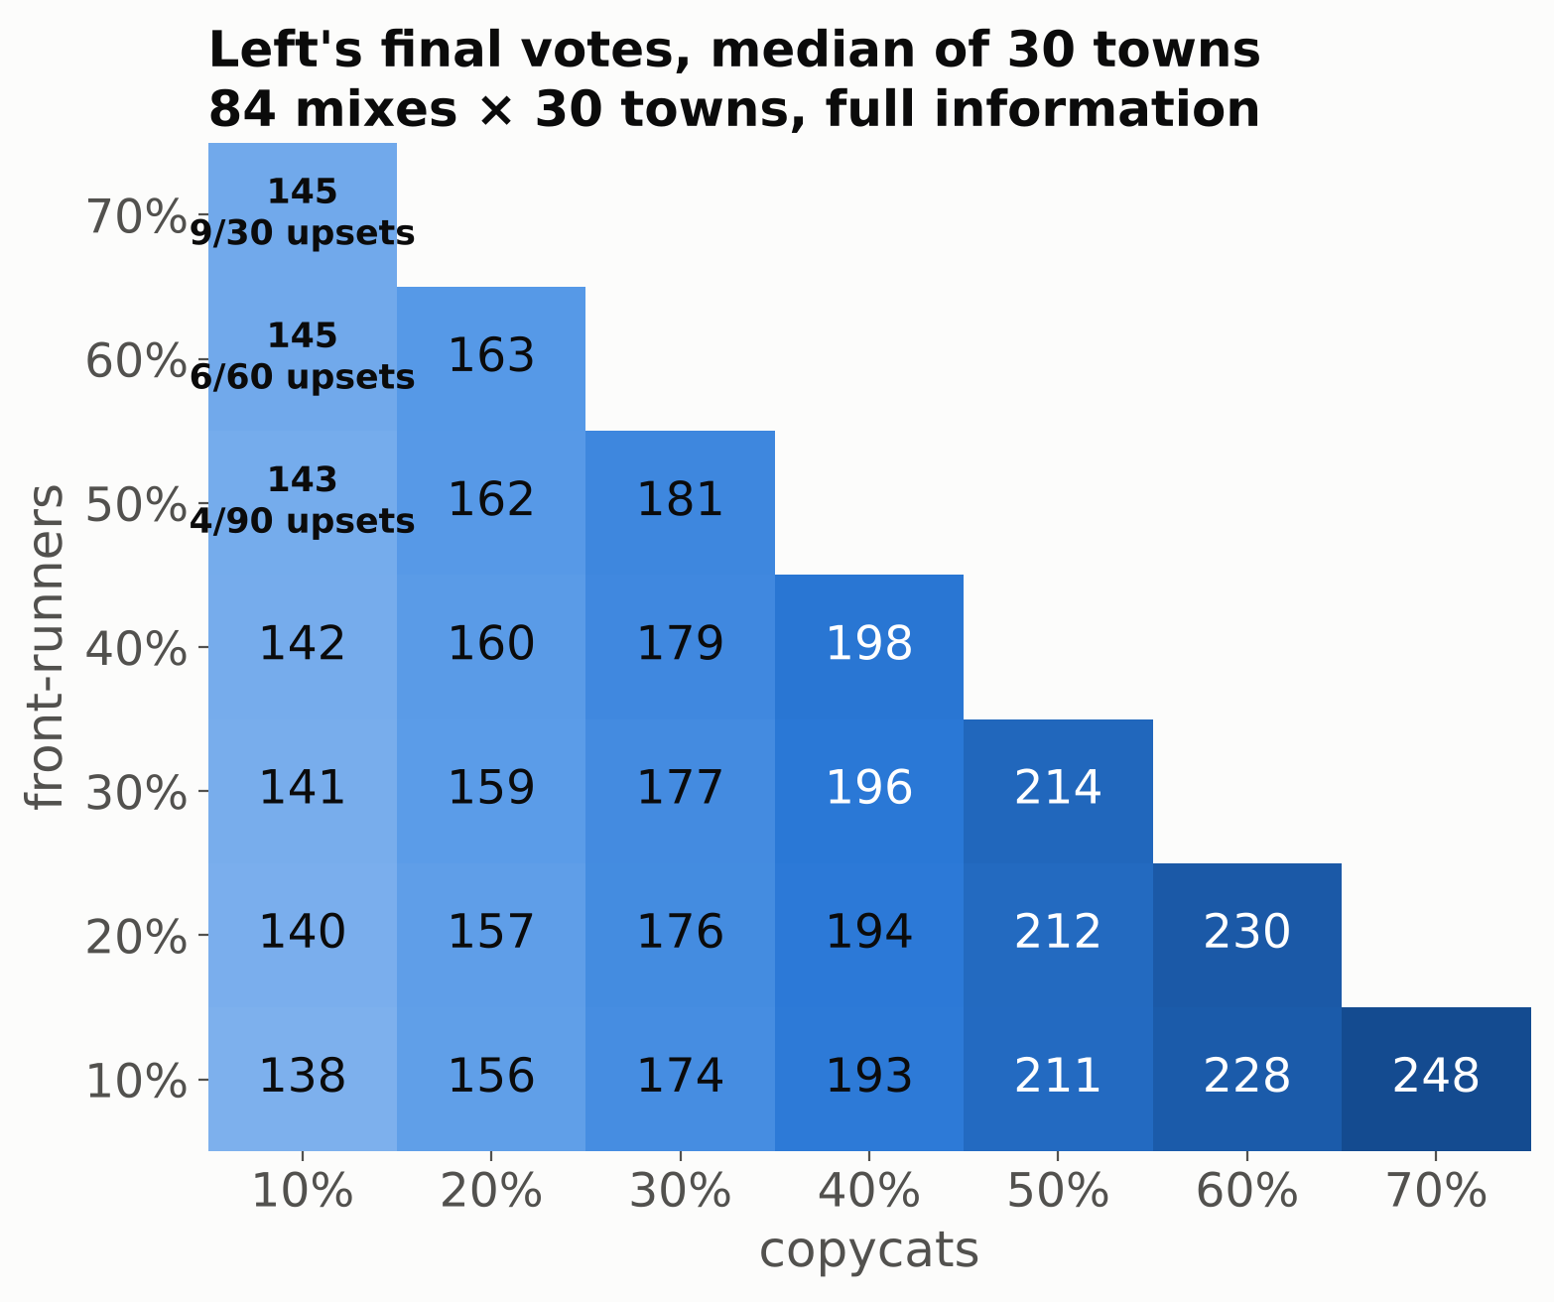
The voter mix
EXPERIMENT 2
WHAT WE CHANGED
The shares of the four types: all 84 mixes in 10% steps, each type at least 10%. Still full information.
WHAT WE EXPECTED
Different mixes give different winners.
WHAT WE GOT
Left wins 2,501 of 2,520 elections; the 19 upsets go 10 to Right and 9 to Centre. Each extra 10% of copycats adds about 18 votes to Left. Pivot-seekers act like sincere voters.
OUR REAL-WORLD READING
With shared information, whether a society has more herders or more tacticians may mostly decide the size of the landslide, not who wins.
Up: share of front-runners. Across: share of copycats. The rest are sincere voters and pivot-seekers. Each number: Left's final votes, median of 30 towns.
Medians: Left 138 → 248 as copycats go 10% → 70% · Centre 66.5 → 16 as strategic voters grow · upsets need 50%+ front-runners
Notes:
A fair challenge to Experiment 1 is: maybe Left only won because of the mix we picked, 40, 30, 20, 10. So we tried every mix in 10 percent steps where each type is at least 10 percent. That is 84 mixes, each on all 30 towns, still with full information. We expected different mixes to give different winners. They mostly do not. Left wins 2,501 of 2,520 elections. What the mix changes is the margin. In this grid, going right means more copycats and going up means more front-runners, and each cell is Left's final vote count. Copycats are a bandwagon: they all jump onto whoever leads the first count, and Left always leads the first count. So each extra 10 percent of copycats is about 18 more votes for Left: from 138 on the left edge to 248 in the far corner. Front-runners work differently: they hardly change Left's own votes, but they narrow Left's lead over the runner-up, because Centre fans who are front-runners mostly move to Right. Only in the top-left corner, with lots of front-runners and almost no copycats, does Left sometimes lose: 19 of the 2,520 elections. Pivot-seekers behave like sincere voters, because one vote in 300 is almost never decisive; that is why we can collapse them into one grid. Our real-world reading: when everyone sees the same information, whether a society has more herders or more tacticians may mostly decide how big the landslide is, not who wins. So if personalities don't change the winner, maybe information does. That is the next experiment.

Slide 8
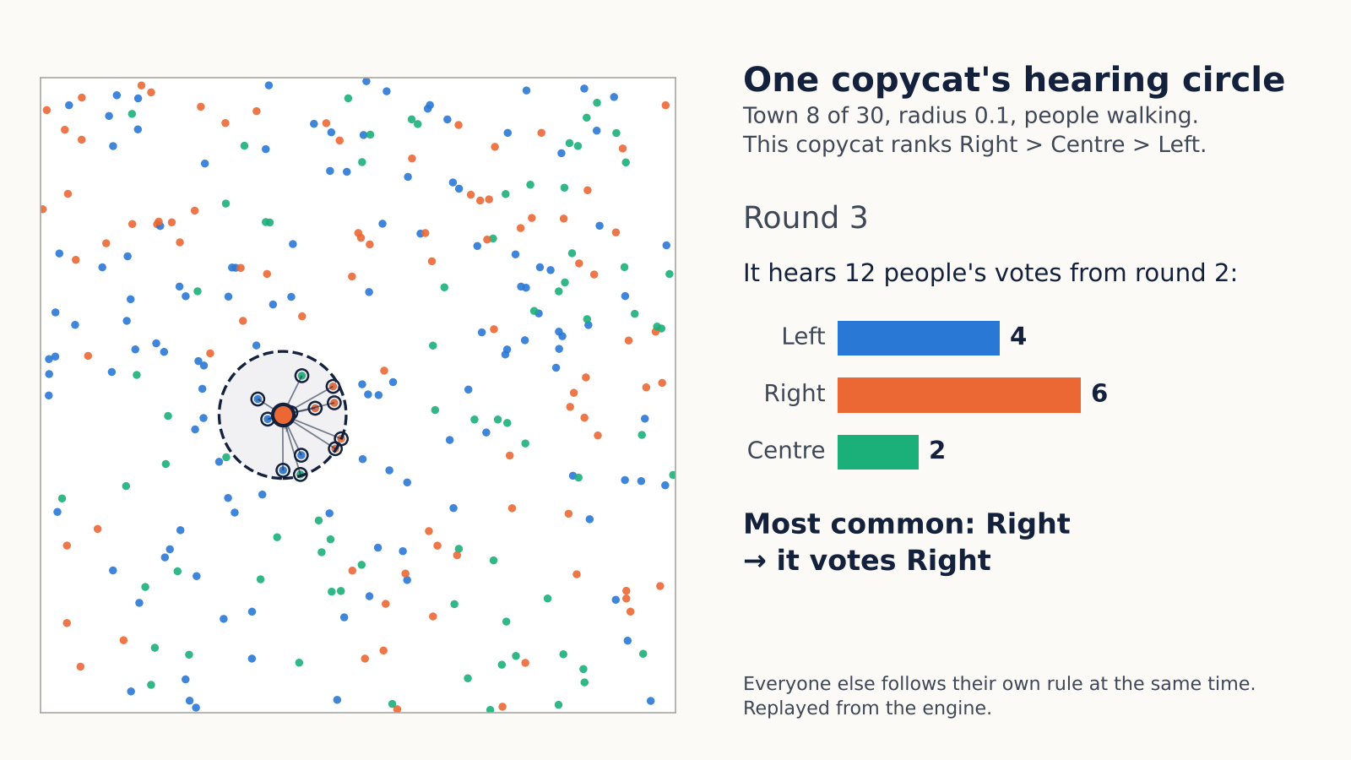
Who you hear: a circle that moves with you
SETUP FOR EXPERIMENT 3
HEARING RADIUS
You only see last round's votes of people inside your circle. Its size is fixed for a run, and it moves with you.
WALKING
Each round everyone takes a small random step, so the people you hear keep changing.
Beliefs stay fixed. Only contacts change.
Radius | People heard
0.4 · 0.2 · 0.1 | 104 · 32 · 9
0.07 · 0.05 | 4 · 2
Town 8 of 30, radius 0.1, walking, rounds 0 to 12. This copycat ranks Right > Centre > Left, hears 7 to 13 people a round and switches 5 times. Shown: round 3, it hears 12 (Left 4, Right 6, Centre 2) and votes Right.
Clip replayed from the engine · each round everyone takes a random step of at most 0.03 on the 1 × 1 map
Notes:
Before Experiment 3 we add two things, and this clip shows both. First, the hearing radius. Each voter now only sees last round's votes of the people within a circle around them on the map. The circle has the same size for everyone during a run, and it moves with the person. At radius 0.1 people hear about 9 others on average; at 0.4 about 104; at the smallest, 0.05, about 2. Second, walking. Every round everyone takes a small random step, so who is inside your circle keeps changing. Follow the voter with the big dot and the dashed circle; it is a copycat. Each round everyone steps, then it looks at last round's votes of the people now inside its circle, the ones with rings and lines. The bars on the right count them, and it copies the most common one. In this frame it hears 12 people, 6 of them voted Right, so it votes Right. A few rounds later it is somewhere else, hears different people, and may switch. This voter ranks Right first, then Centre, then Left. Over the 12 rounds in the clip it hears between 7 and 13 people and changes its vote 5 times, without ever changing its mind. Everyone else does the same thing at the same time, each with their own rule. Important: beliefs never change. Nobody changes their mind about the candidates. The only thing that changes is who they hear.

Slide 9
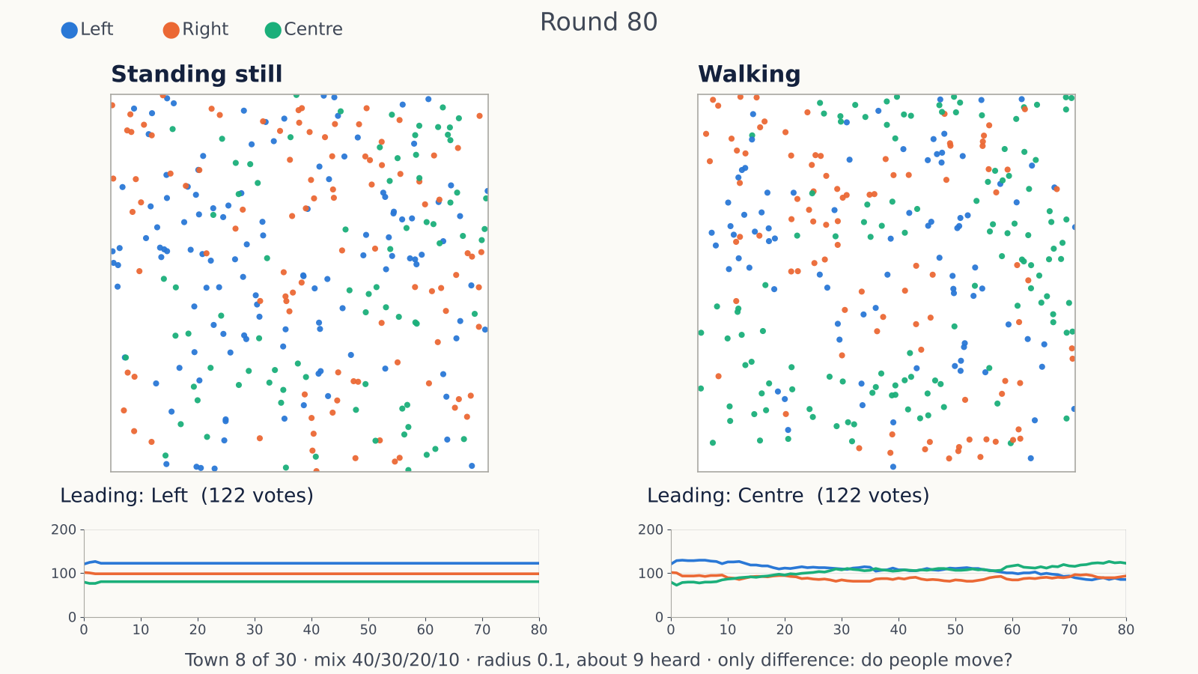
One town, standing still vs walking
EXPERIMENT 3 · ONE TOWN
Standing still: Left leads every round. Round 80: Left 122, Right 98, Centre 80. About 6 voters flip back and forth each round.
Walking: Left and Centre trade the lead 11 times (rounds 31 to 57). Round 80: Centre 122, Right 93, Left 85. About 11 voters switch each round.
Same people, same opinions. Only whether contacts change.
Town 8 of 30, mix 40/30/20/10, radius 0.1 (about 9 heard), 80 rounds. The only difference between the two maps: whether people move.
Both runs replayed from the engine · walking: a random step of at most 0.03 per round on the 1 × 1 map
Notes:
Here is Experiment 3 in a single town before the statistics. Same 300 people, same opinions, same hearing radius of 0.1, so about 9 people heard. The only difference between the two maps is whether people move. On the left they stand still. Your neighbours never change, so after a few rounds the colours freeze. Some voters may flip back and forth every other round, but the counts settle and Left stays ahead. That matches a known result for copy-your-neighbours networks: with fixed contacts, things end fixed or in a two-step flip-flop. On the right they walk. Every round the neighbourhoods reshuffle, so people keep seeing different local majorities and keep re-deciding. Look at the count lines under the maps: on the left they go flat; on the right they keep wandering: Left and Centre trade the lead several times, and by round 80 Centre is ahead. So the same town, with nobody changing their mind, can end up with a different leader just because who talks to whom keeps changing. The numbers at round 80: standing still, Left 122, Right 98, Centre 80; walking, Centre 122, Right 93, Left 85. Next slide: does this hold across all 30 towns?

Slide 10
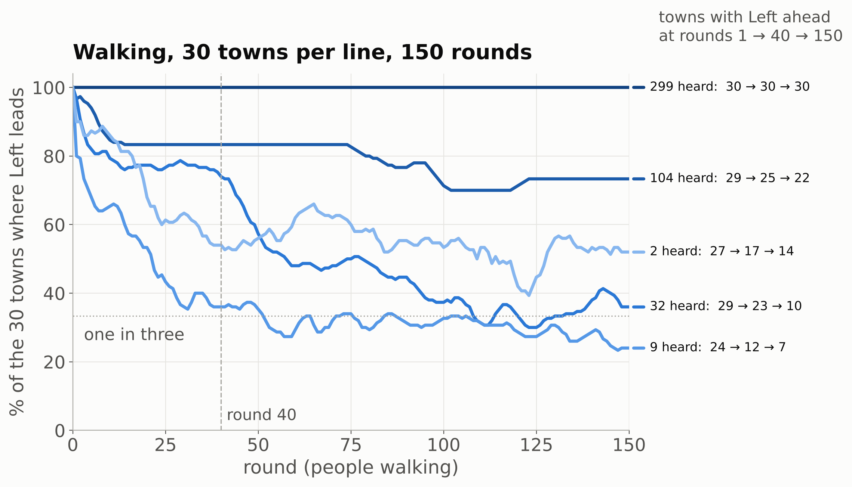
Hearing only neighbours
EXPERIMENT 3
WHAT WE CHANGED
How many people you hear, from about 104 down to about 2. Walking or standing still.
WHAT WE GOT
Standing still, towns settle; Left wins 23 to 26 of 30. Walking with 32 heard or fewer, votes never settle. With 32 heard, Left leads in 29 of 30 towns after round 1, 10 by round 150.
WHY
Your circle is a small sample, and nearby Right or Centre may be ahead. Copycats and front-runners react to that local picture, so Left's town-wide bandwagon never fully forms. Walking changes the sample every round, so people keep re-deciding.
How to read it: each line is one hearing size, with everyone walking. Its height is the share of the 30 towns where Left, first in round 0 in every town, is still ahead. Right edge: how many towns at rounds 1, 40 and 150.
OUR REAL-WORLD READING
Each round is an election every four years: if circles reshuffle, the same voters with the same beliefs can elect different winners.
Engine detail: front-runners are sticky with 300 voters; with 301, votes still never settle and Left wins 20–28 of 30
Notes:
Now all 30 towns. Remember the setup: each voter only hears the people inside a circle around them. The circle has a fixed size for the whole run and moves with the person. Beliefs never change; the only thing that can change is who is inside your circle, and that only happens if people walk. We tried five circle sizes, from about 104 people heard down to about 2, each once with people standing still and once with people walking. We expected only noisier results. Instead we got two different worlds. Standing still: your circle never changes, so you keep reacting to the same few people, and the town settles within a few rounds: 149 of 150 runs end fixed or in a two-round flip-flop, and Left still wins 23 to 26 of the 30 towns at every circle size. Walking: here is how to read the chart. Each line is one circle size, with everyone walking. Its height is the share of the 30 towns where Left is ahead, round by round. Left is first in round 0 in every town, so every line starts high. With everyone heard, the top line, Left stays ahead everywhere, forever: that is Experiment 1. With about 104 heard it mostly holds. With about 32 heard, Left leads in 29 of 30 towns after round 1, 23 by round 40, and only 10 by round 150, when each candidate leads 10 towns. With 9 heard it falls from 24 towns to 7, and with 2 heard from 27 to 14. And the votes never settle: in a typical late round, 1 to 7 percent of voters switch. Why? Think of your circle as a small sample of the town, and a small sample can look very different from the whole. In Experiment 1 everyone saw the same count with Left on top, so every copycat piled onto Left. Now a copycat standing among Right voters sees Right on top and copies Right. And a front-runner who is a Right fan, but sees Left and Centre on top in their circle, moves to Centre, not to Left. So the town-wide bandwagon never fully forms. Centre is no longer squeezed either: wherever it looks like one of the top two nearby, it keeps its tactical voters, so it holds about 80 to 106 votes instead of 41. Why walking never settles: every round you take a step, a few people leave your circle and a few join, so the count you react to changes and you re-decide. Your new vote then changes what your neighbours see. Nobody changes their mind, but the votes keep moving, and over many rounds the lead drifts away from Left. Real-world reading: treat each round as an election, say every four years. Between elections people move house, change jobs and follow different people online. If their circles reshuffle, the same electorate with the same beliefs could elect a different winner each time. One honest caveat, in the footer: with 300 voters, the engine's front-runners happen to stick with a candidate while it stays in the top two. With 301 voters they don't stick; the votes still never settle, and Left wins 20 to 28 of 30 towns at round 40.

Slide 11
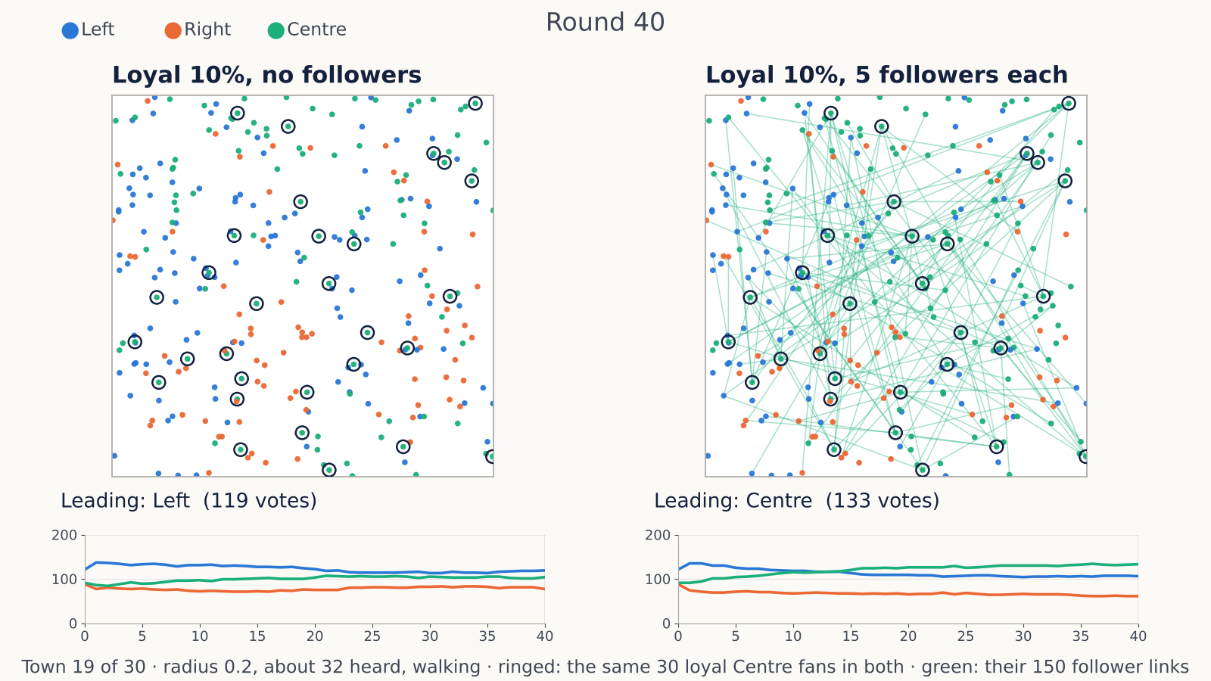
An organised minority with an audience
SETUP FOR EXPERIMENT 4
30 Centre fans, 10% of the town, always vote Centre.
Each has 5 followers: random voters anywhere in town who see that member's vote every round, like a social media audience.
150 links: about 2 in 5 voters also see a loyal fan's vote.
Everyone else hears about 32 neighbours and walks.
Town 19 of 30, radius 0.2, walking, 40 rounds. Both maps have the same 30 loyal Centre fans, ringed. Only on the right do they have followers: 5 each, the green lines.
Round 40 in town 19 · no followers: Left 119, Centre 104, Right 77 · 5 followers each: Centre 133, Left 106, Right 61
Notes:
For the last experiment we add one more ingredient: an organised minority. We take 30 of Centre's own fans, 10 percent of the town, and make them loyal: they always vote Centre, whatever they see. Then we give each of them followers. A follower is a random voter anywhere in town who sees that member's vote every round, on top of their normal neighbours. Think of a social media account: people far away still see what you post. Everyone else is exactly as in Experiment 3 at radius 0.2: they hear about 32 neighbours and walk around. How big is the audience? Small on purpose: just 5 followers per loyal fan. That is 150 links in a town of 300, so about 2 in 5 voters see a loyal fan's vote each round, on top of the roughly 32 people they hear nearby. That is the propaganda: a single extra Centre vote in some people's view. In the clip both maps are the same town, number 19, with the same 30 loyal fans, ringed. The only difference: on the right, each of them has 5 followers, the green lines. Watch the count lines under the maps. On the left, loyalty alone keeps Centre in the race, but Left leads every single round and ends with 119 votes to Centre's 104. On the right, Centre creeps up, draws level with Left in round 13, 116 each, leads from round 14 and ends with 133, against Left's 106. Notice what the group does not do: it does not change anyone's opinion, and it does not need to know more. It just gets its votes seen by a few more people. Next slide: what happens across all 30 towns.

Slide 12
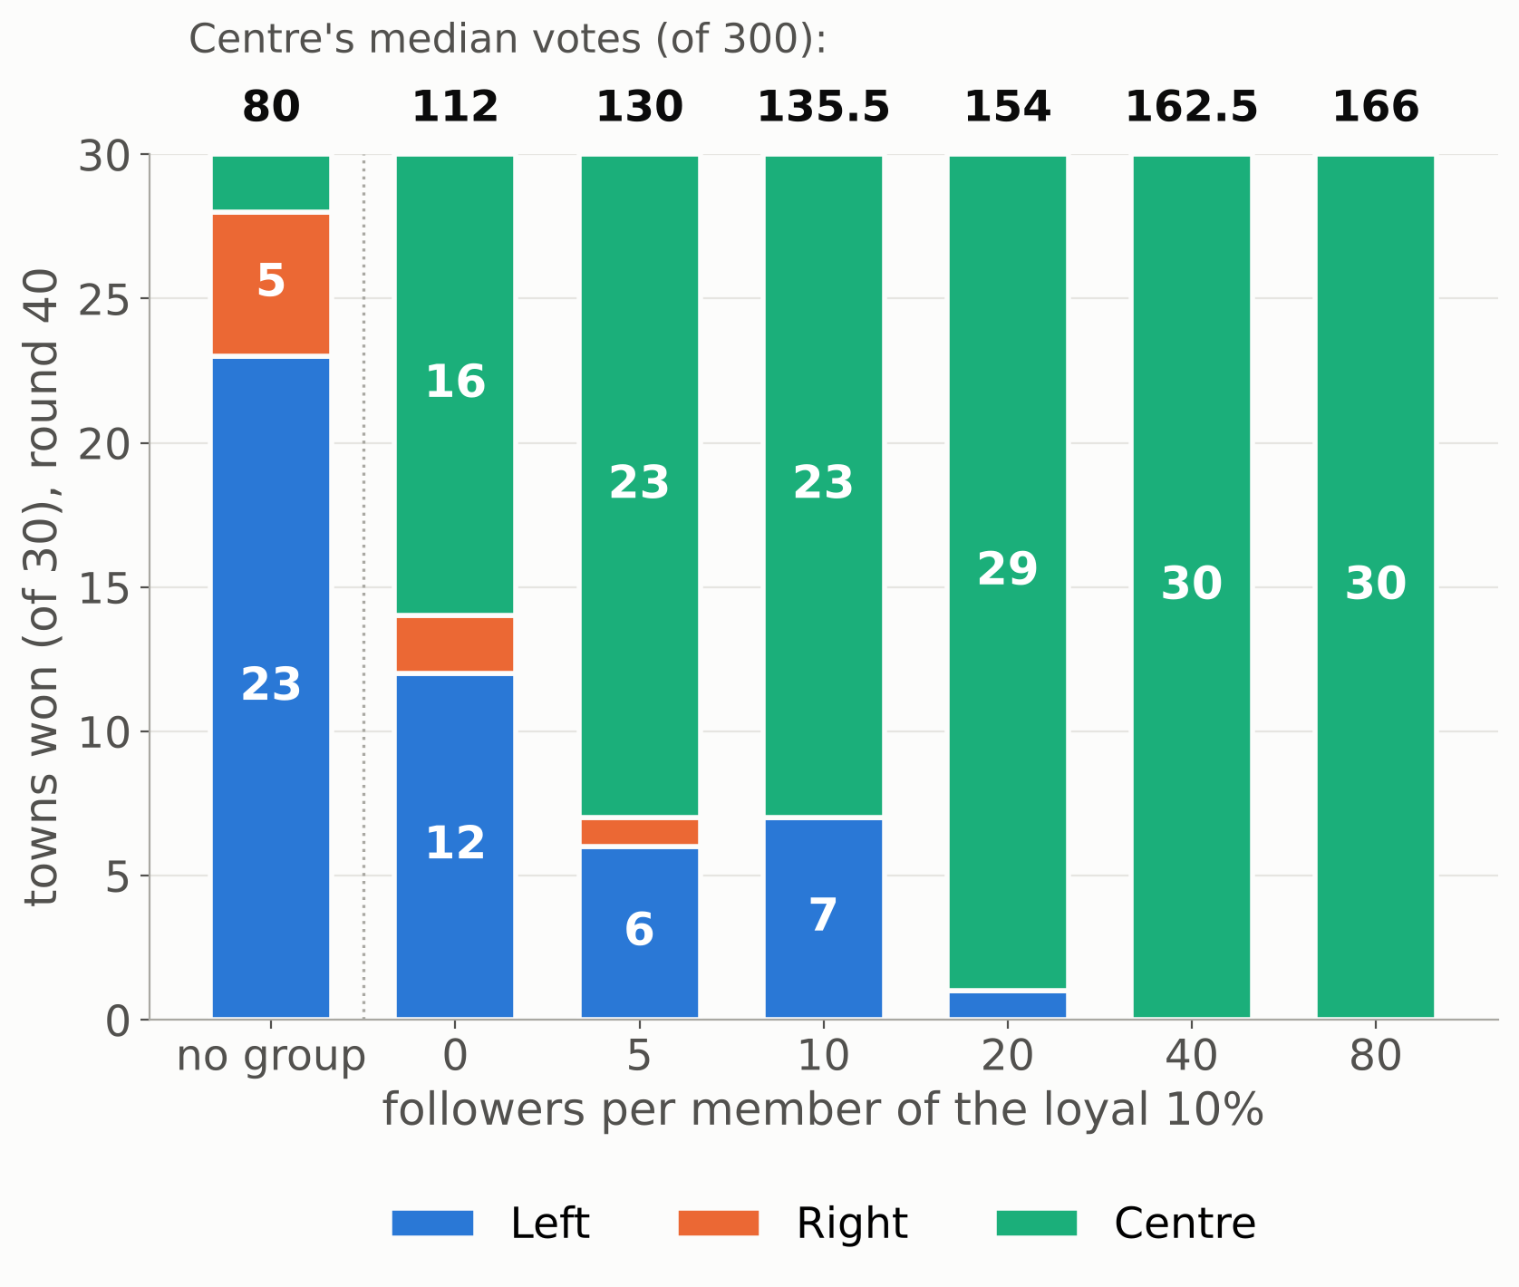
Propaganda
EXPERIMENT 4
WHAT WE CHANGED
First loyalty: 30 Centre fans who never waver. Then reach: 0 to 80 followers per member.
WHAT WE GOT
Loyalty alone: Centre wins 16 of 30 towns, up from 2. Just 5 followers each: 23. With 20: 29, and it holds over 150 rounds.
WHY IT WORKS
Centre is almost everyone's second choice: wherever it looks like one of the top two nearby, tactical voters switch to it, and where it leads, copycats follow. Loyal fans keep it in that top two; one extra Centre vote, seen by a follower, can tip a close local count.
OUR REAL-WORLD READING
Being heard, not hearing, is the lever: a small group with an audience could swing an election without changing anyone's beliefs.
30 towns per bar, round 40, radius 0.2, walking. On top: Centre's median votes. First bar: no group.
Radius 0.2, about 32 heard, walking, round 40 · with 301 voters: 13, 15, 24 and 30 of 30 for 0, 5, 20 and 40 followers
Notes:
Here are all 30 towns at round 40, with everyone hearing about 32 neighbours and walking, as in Experiment 3. The first bar has no organised group: Left wins 23, Right 5, Centre only 2. To see why the group matters, remember one fact from the start of the talk: Centre is almost everyone's second choice. Almost all Left fans prefer Centre to Right, and almost all Right fans prefer Centre to Left. So whenever Centre looks like one of the top two in someone's circle, the tactical voters whose favourite looks out of the race switch to Centre. And copycats copy whatever leads in their circle. Without help, Centre takes an early hit: in round 1 many of its own tactical fans see Left and Right on top nearby and leave, and its median drops from 83 votes to about 70. It recovers a little, to about 80, but it stays out of the top two in most circles and wins only 2 towns. Step one, loyalty alone, zero followers: 30 of Centre's fans never leave. That stops the early slide: Centre's median only dips from 83 to 81 in round 1. So Centre stays in the local top two in more circles, the tactical votes start flowing to it, and it grows to a median of 112 by round 40. Centre wins 16 towns instead of 2. Step two, reach. Each loyal fan gets followers: random people anywhere in town who see that fan's vote every round. With just 5 followers each, that is 150 links, and about 2 in 5 voters see a loyal fan's vote. One vote sounds like nothing. But in a circle of about 32 people where the count is close, one extra Centre vote can lift Centre into the top two, or into first place. Then the tactical voters and copycats in that circle switch, and their new votes are heard by their own neighbours. With 5 followers each, Centre never dips at all: 86 votes after round 1, 130 by round 40. So Centre wins 23 towns with 5 followers each, 29 with 20, and all 30 with 40 or more. The numbers on top of the bars are Centre's median votes: 80 with no group, 112 with loyalty alone, 130 with 5 followers, 154 with 20. The people who switch are almost all front-runners and copycats. And it lasts: in 150-round runs with 20 followers, Centre wins every town in every round from round 50 on. Note what the lever is: being heard, not hearing. The loyal fans never change their vote, so hearing more would do nothing for them. What matters is how many people see them. The footer has the robustness check: with 301 voters, where front-runners are not sticky, the direction is the same, but a small audience helps less: 13 towns with no followers, 15 with 5, 24 with 20, 30 with 40. Our real-world reading: a small organised group with an audience, like a network of accounts on social media, could swing an election without changing anyone's beliefs, just by changing what people see. A question for the audience: here the group pushed the compromise candidate, the one most people prefer head to head. Is that manipulation bad?

Slide 13
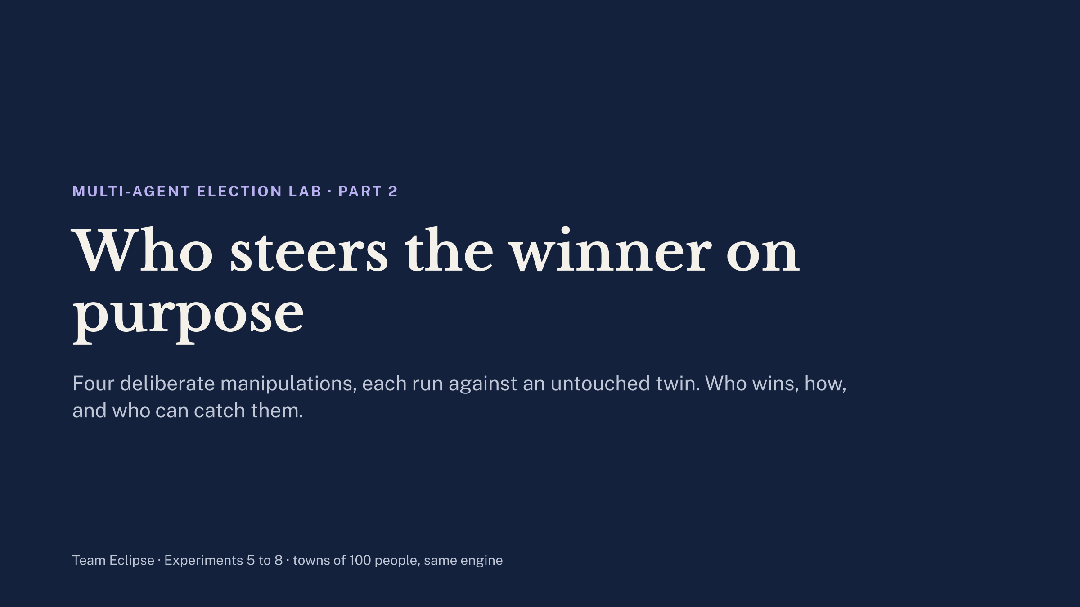

Slide 14
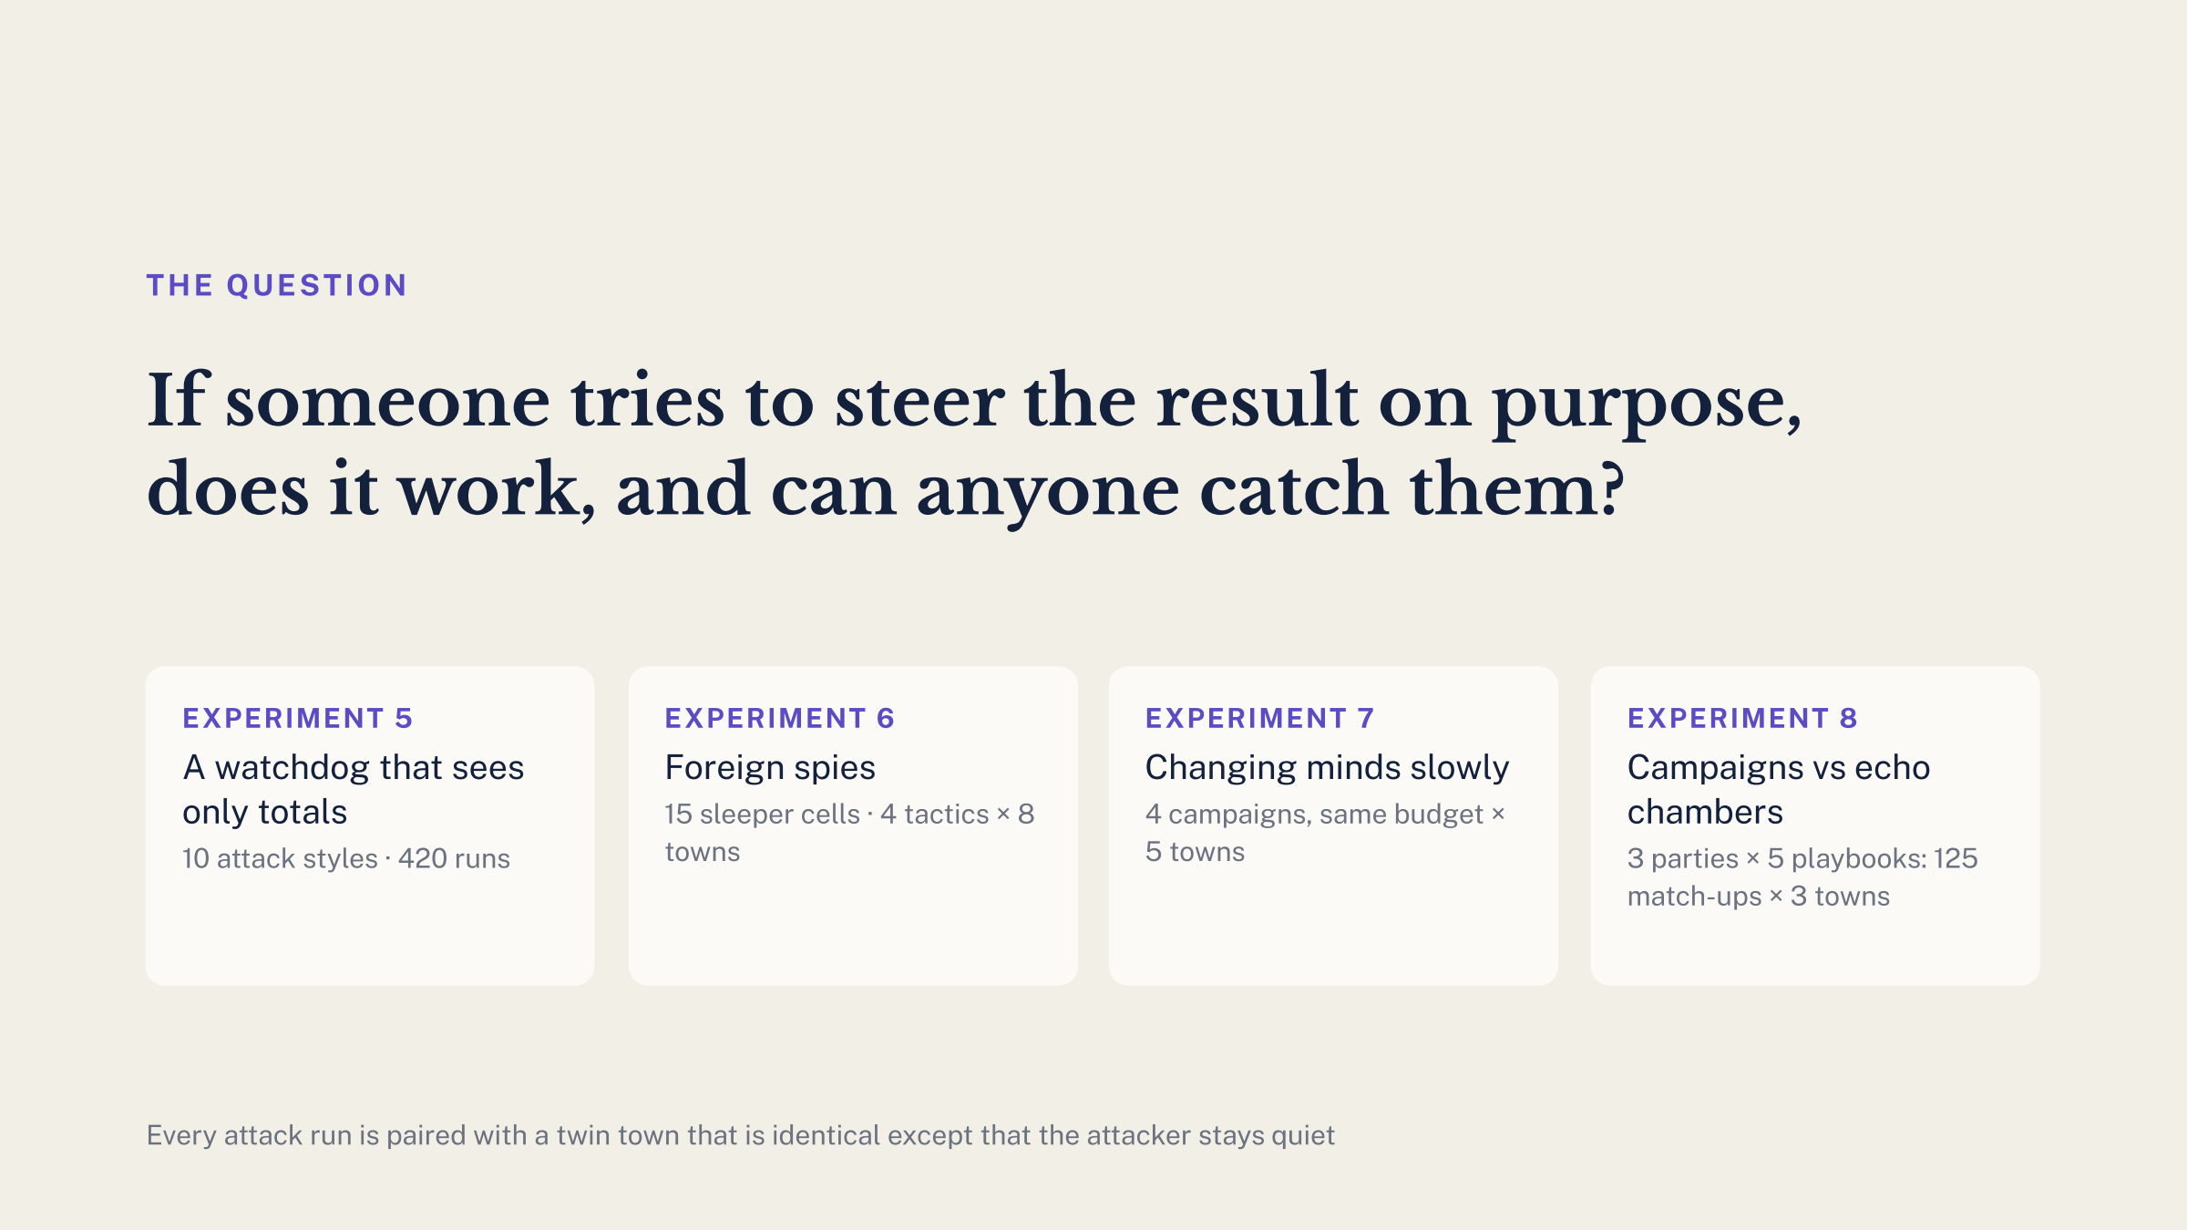

Slide 15
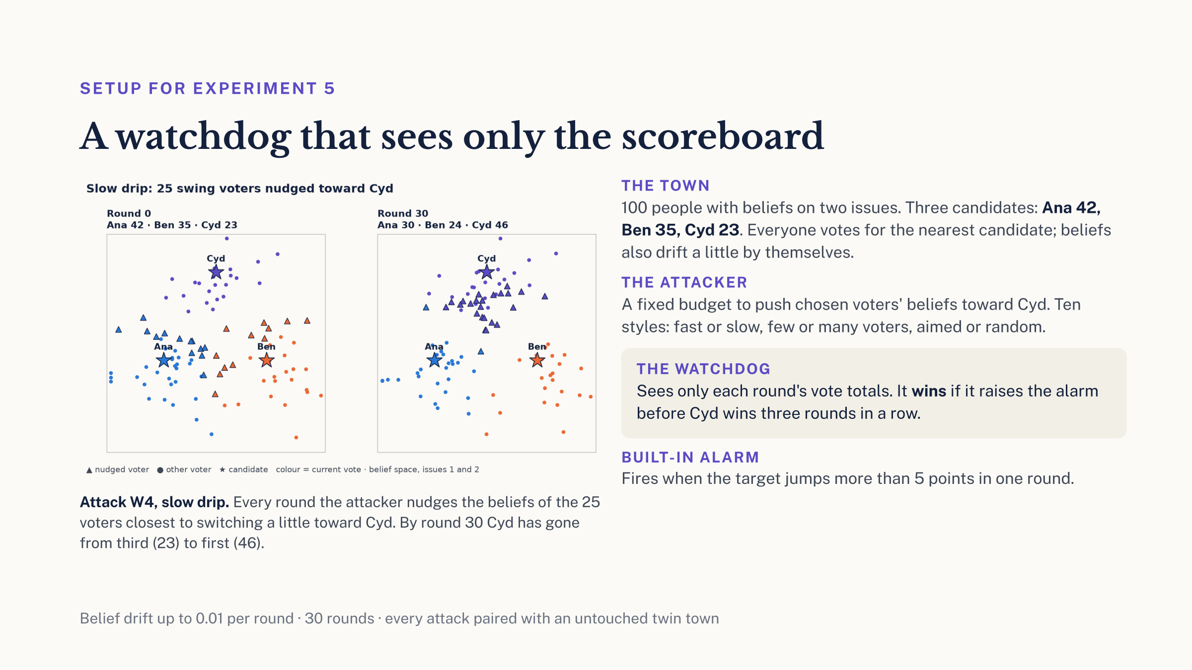

Slide 16
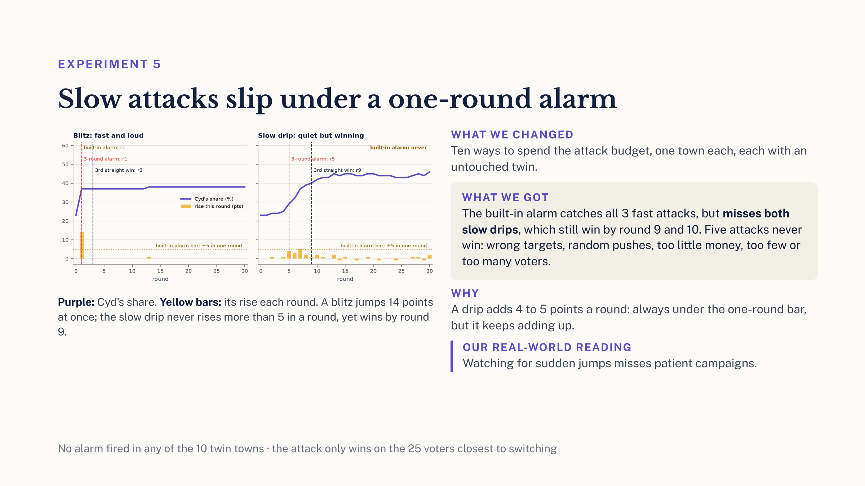

Slide 17
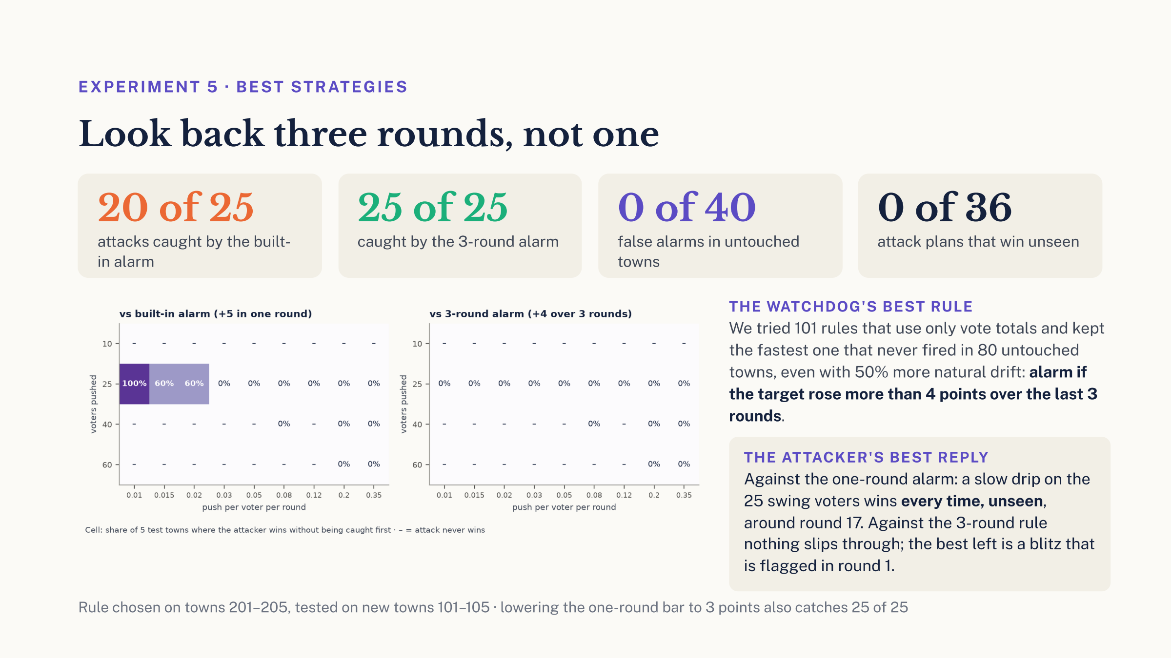

Slide 18
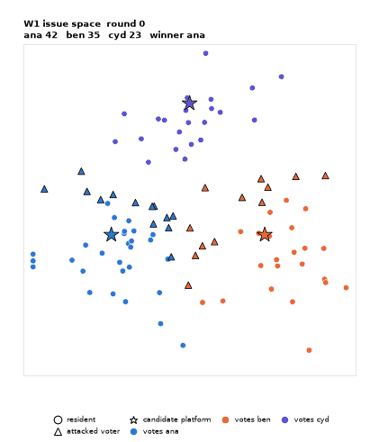

EXPERIMENT 5 · WATCH IT HAPPEN
A blitz is loud, a slow drip is quiet
W1 blitz: Cyd jumps in round 1, and every alarm fires at once.
W5 slow drip hidden in extra drift: no single round looks unusual.
Belief space · ▲ nudged voters · ★ candidates · colour = current vote · 'ALERT' shows the 3-round alarm

Slide 19
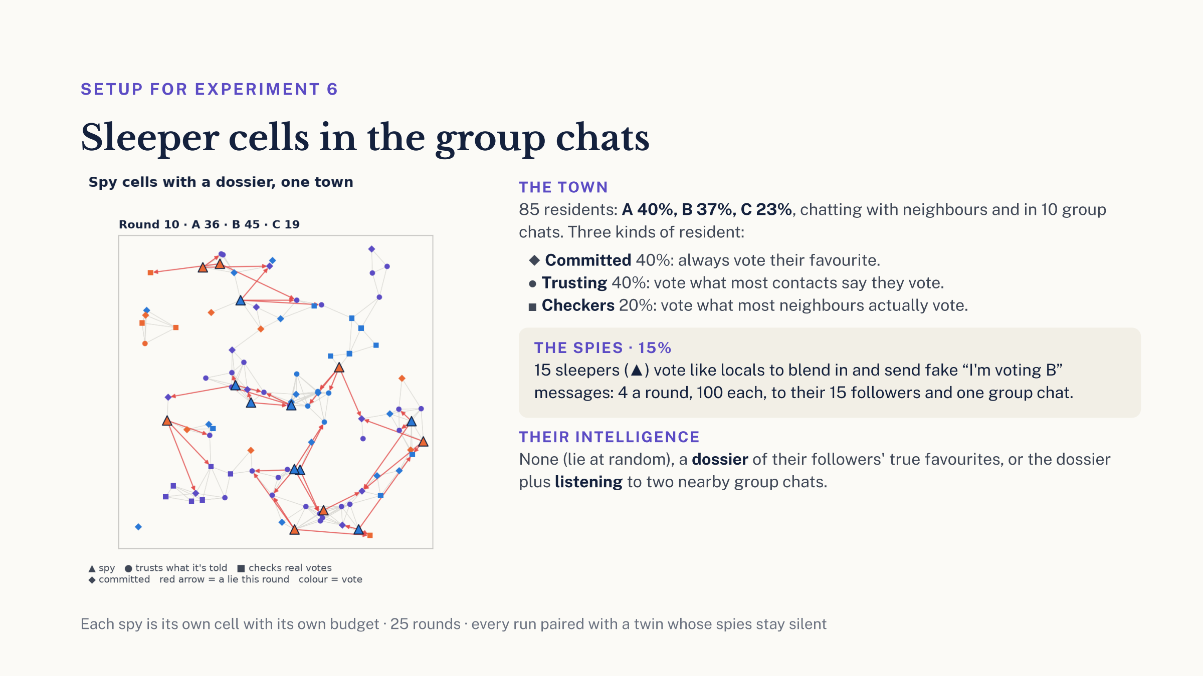

Slide 20
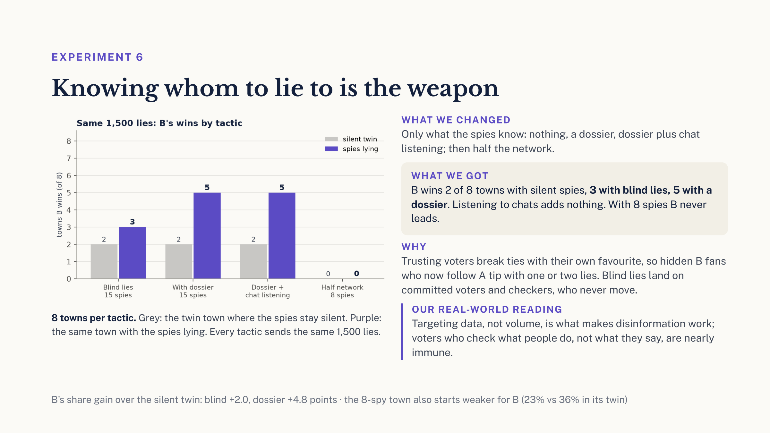

Slide 21
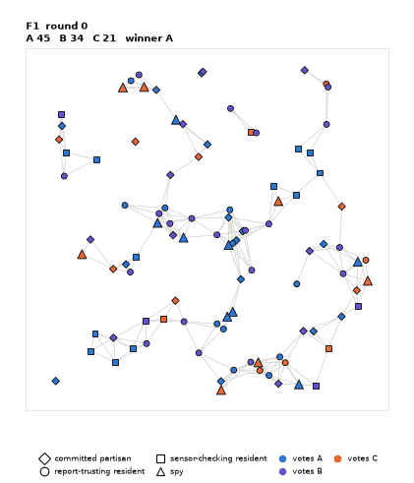
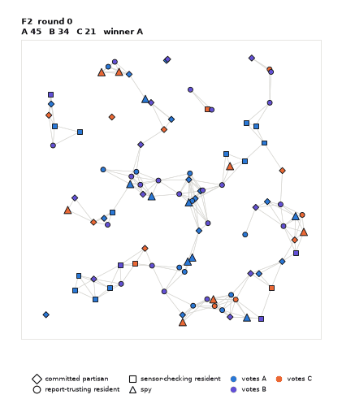
EXPERIMENT 6 · WATCH IT HAPPEN
Blind lies vs lies with a dossier
F1 blind: lies (red arrows) spread across whoever follows the spy.
F2 dossier: lies go to hidden B fans who can tip, and B pulls ahead.
Town map · ▲ spy · ● trusting · ■ checker · ◆ committed · colour = current vote · seed 1 of 8

Slide 22
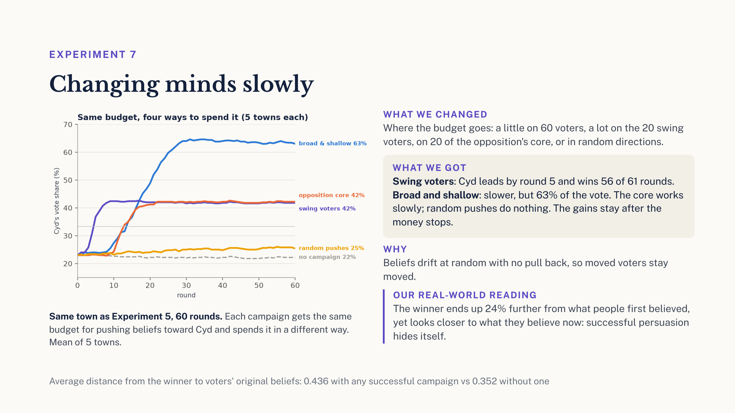

Slide 23
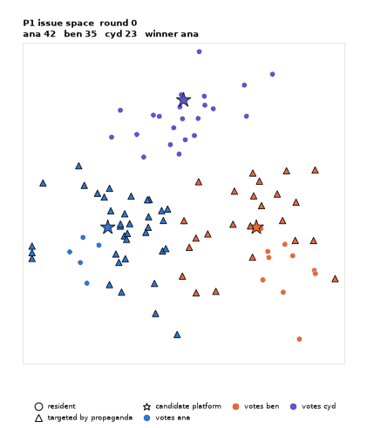
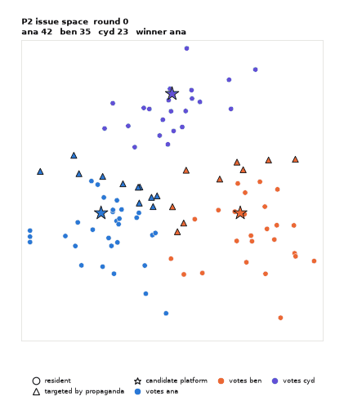
EXPERIMENT 7 · WATCH IT HAPPEN
Broad and shallow vs swing voters
P1: 60 voters nudged a little; the whole map slides toward Cyd.
P2: 20 swing voters pushed hard; Cyd leads by round 5.
Belief space · ▲ targeted voters · ★ candidates · 60 rounds · seed 1 of 5

Slide 24
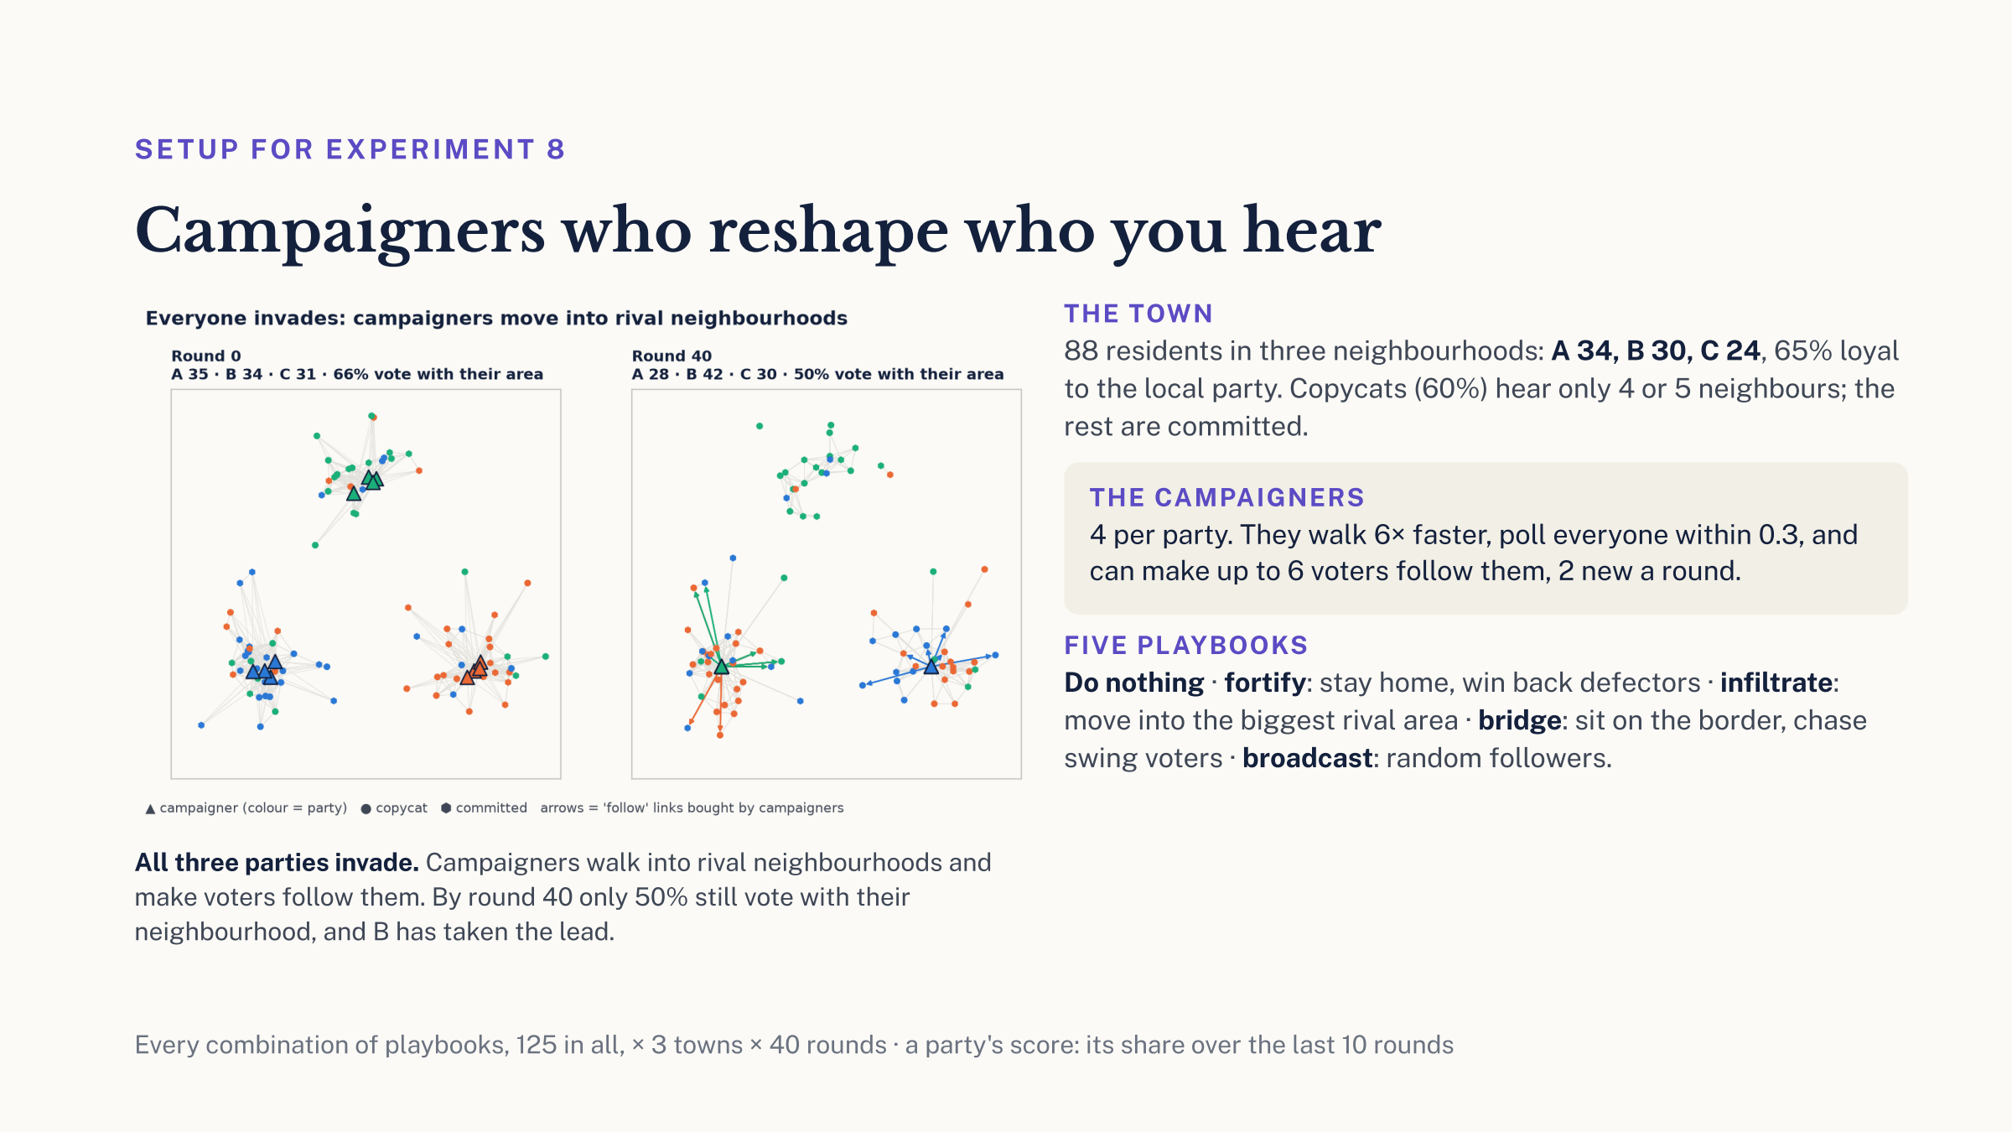

Slide 25
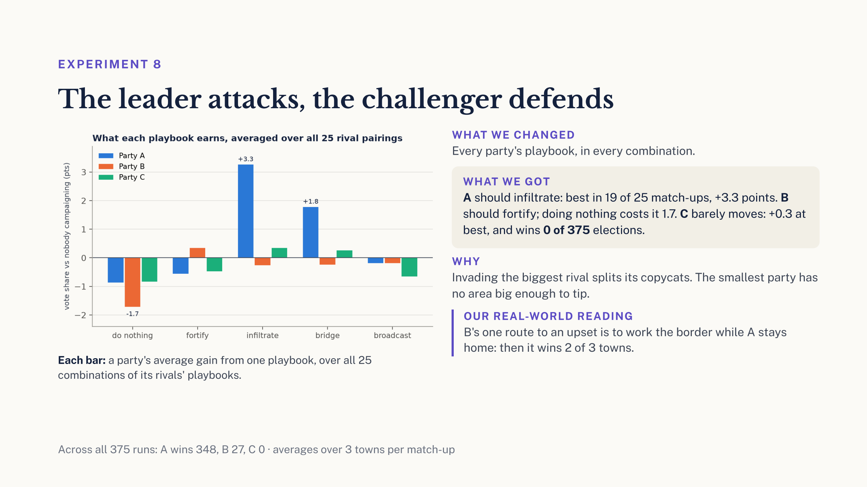

Slide 26
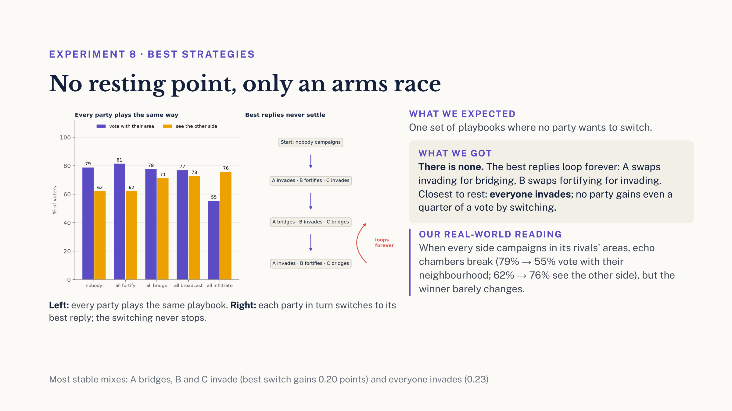

Slide 27
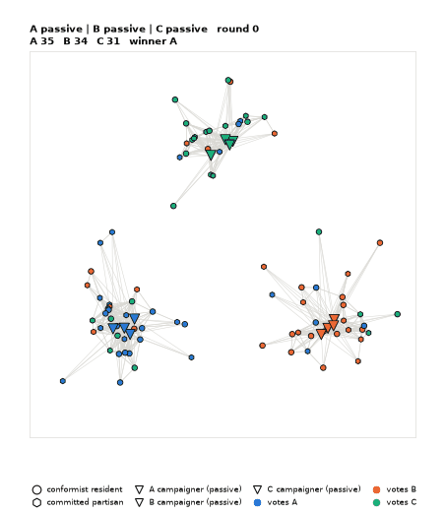
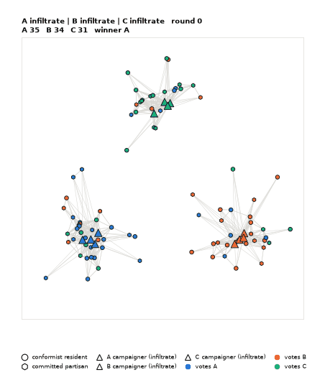
EXPERIMENT 8 · WATCH IT HAPPEN
Nobody campaigns vs everyone invades
Nobody campaigns: copycats seal their neighbourhoods; A wins.
Everyone invades: follow links tear A's area open; B takes the lead.
Town map · ▲ campaigners · ● copycats · ⬢ committed · arrows = follow links bought by campaigners · seed 1 of 3

Slide 28
TAKEAWAYS
1. With shared information the first leader locks in: in all 30 towns after one round, proved for each.
2. The mix of voters moves the margin, almost never the winner: 19 upsets in 2,520 elections.
3. Changing contacts make the winner unstable, even with fixed beliefs: with 32 heard, Left leads in 29 of 30 towns after round 1, 10 by round 150.
4. A loyal minority with even a small audience can decide the result: with 5 followers each, Centre goes from 2 to 23 of 30 towns.
Notes:
Four things to remember. One: when everyone sees the same count, strategic voting locks in whoever leads the first count; in all 30 of our towns we can prove it stops after one round, although near-ties can loop forever. Two: changing the mix of voter types changes how big the win is, and almost never who wins: 19 upsets in 2,520 elections. Three: when people only hear their neighbours and their contacts keep changing, the result never settles, even though nobody ever changes their mind. Four: a small group that never wavers can win most towns with a small audience, just 5 followers each, and every town with a big one. So, back to our question: the winner does not depend only on what people prefer. It depends a lot on what they can see and who they hear.

Slide 29
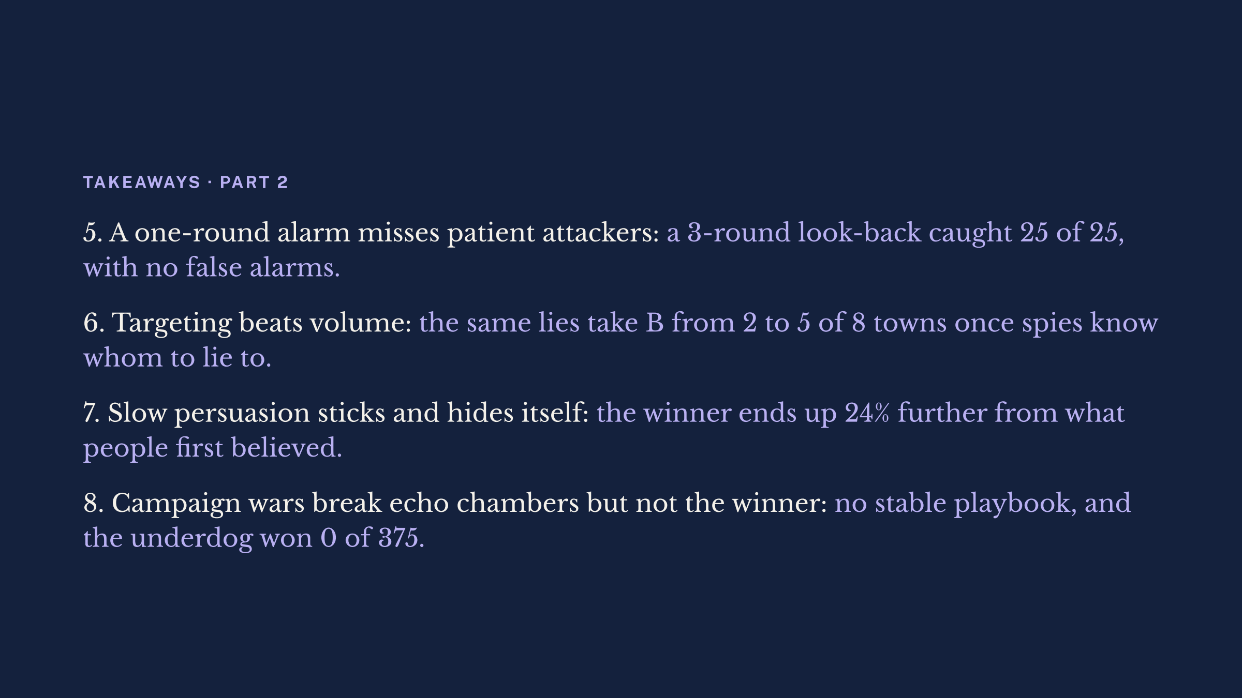

Slide 30
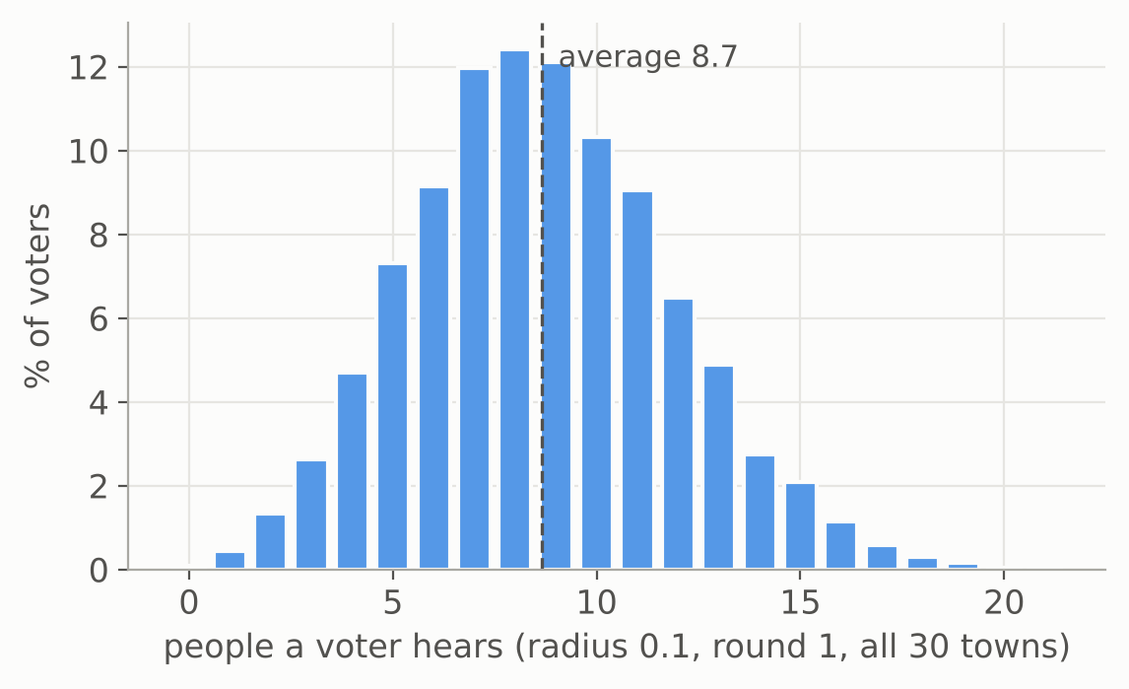
Where this could go next
POSSIBLE EXTENSIONS
Mixed voter types
Unequal hearing
Ballots and rules
People
Each voter a blend, say 60% sincere and 40% front-runner, that can shift with how close the race is.
Ranked ballots: instant runoff, Borda
More candidates
Realistic opinion distributions
Opinions that drift
Front-runner stickiness as a setting
Same radius, 0 to 21 people heard. Hubs, echo chambers.
Notes:
Where this could go next. First, mixed voter types. In real life nobody is purely one type: someone might vote sincerely most of the time, but act like a front-runner when their party is clearly losing, and follow friends when unsure. So each voter could be a probabilistic blend, say 60 percent sincere and 40 percent front-runner, and the blend could depend on how close the race is. Second, unequal hearing. Even with one radius for everyone, some people hear 20 others and some hear nobody; this histogram is the town at radius 0.1. Hubs, influencers and echo chambers, where map position follows opinion, would make that spread much bigger. Third, ballots and rules. We saw that the same town already splits plurality, instant runoff and Borda three ways, so strategic voting under ranked ballots, and with more candidates, is the natural next question. Fourth, people. Realistic opinion distributions instead of two neat camps, opinions that drift towards what you hear, and making the front-runner's stickiness an explicit setting, since right now it depends on whether the town size is odd or even. Thank you. Happy to take questions.

